Slide 1

SpamSpotter: An Efficient Spammer Detection Framework based on Intelligent Decision Support System on Facebook
Presented By: Under the guidance of:
Kodingari Rajasekhar(202IT009) Dr. Jaidhar C. D.
Manaswita Datta(202IT011)
Department of Information Technology, NITK, Surathkal

Slide 2
CONTENT
Introduction
Dataset
System Requirement
Methodology
Data Visualization
Data pre-processing
Experiment and Results
Dissimilarity Graphs
Conclusion
Reference

Slide 3
Introduction
With the increasing number of users on Facebook, the probability of broadcasting spam content on it is also increasing day by day.
The spam post or content on Facebook is transmitted by a malicious user, who is known as a spammer. Their goal mostly is to seek financial gain.
Motivated by the need to identify spam contents, a novel SpamSpotter framework based on the Intelligent Decision Support System is proposed.
The intelligent decision support system uses eight different machine learning classifiers on the dataset to distinguish spammers from legitimate users.

Slide 4
Dataset
Dataset: Kaggle’s Facebook spam dataset
No. of features: 13 + 3(derived)
No of legitimate and spammers users: 500 and 100 respectively
Profile-based features | Content-based features | Derived features
Number of friends | Fraction of the posts containing URLs | Average number of posts shared per day
Number of followings | Fraction of the posts containing photos/videos | Average number of URLs shared per day
Number of Community | Average number of comments per post | Average number of photos/videos shared per day
The age of the user account (in days) | Average number of likes per post
Total number of posts shared | Average number of tags in a post
Total number of URLs shared | Average number of hashtag present in a post
Total number of photos/videos shared
Table: List of Features

Slide 5
System Requirement
Language : Python
IDE : Google Colab

Slide 6







Methodology
Random Forest,
k-Nearest Neighbors, Logistic Regression, Support Vector Machine, Decision Tree,
Bayesian Network
Dataset
Data visualization and preprocessing
Training Data
Test Data
Evaluation

Slide 7
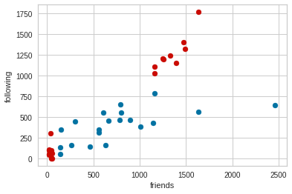
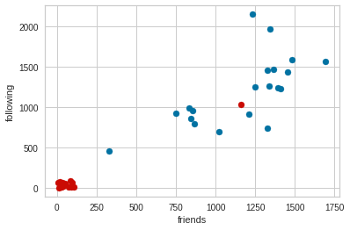
Data Visualization
x axis vs y axis | Contiguous data | Non-contiguous data
friends vs followings
Note :- Blue : Legitimate user, Red : Spammer

Slide 8
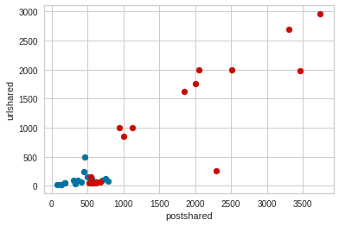
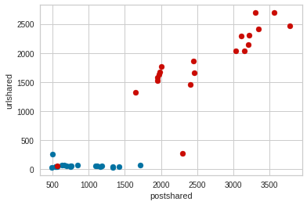
Data Visualization(2)
x axis vs y axis | Contiguous data | Non-contiguous data
postshared vs urls shared
Note:- Blue : Legitimate user, Red : Spammer

Slide 9
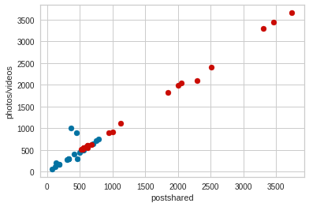
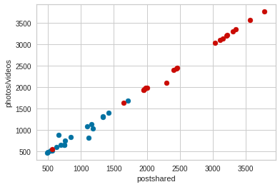
Data Visualization(3)
x axis vs y axis | Contiguous data | Non-contiguous data
Postshared vs photos/videos shared
Note :- Blue : Legitimate user, Red : Spammer
From all the visualizations, we can see that the behaviour of spammer for both contiguous and con-contiguous data does not vary much. Same thing we can observe for legitimate user too.

Slide 10
Data pre-processing
1. Inspecting column for missing values : Replace the missing values with mean of that column.
2. Check for duplicate rows : No duplicate row found.
3. Add the derived attributes : Total 3 derived attribute is added.
4. Pair-wise plot of the data feature in added in the folder with name “pairwise.png”.
5. Normalization : The value range of all the variable are different. So we did normalization.

Slide 11
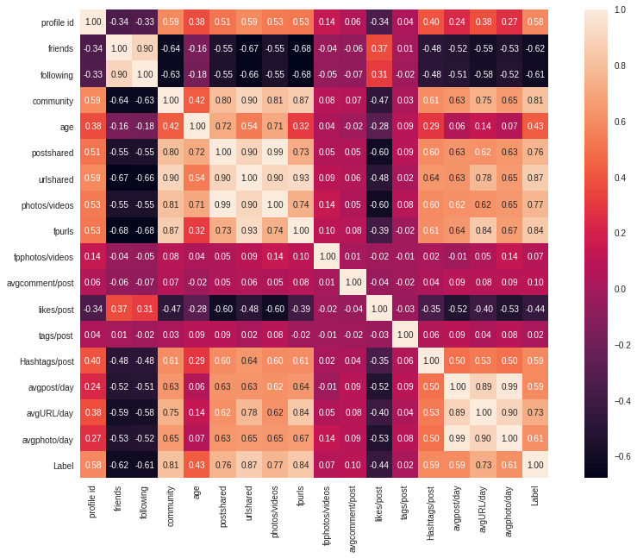
Data pre-processing(2)
6. Pair-wise correlation among the column :
i. Heat map (fig) : From the heat map, we can see that ‘postshared’ and ‘photos/videos’ are highly correlated. So are ‘avgphoto/day’ and ‘avgpost/day’.
ii. Pearson’s correlation: This technique also showed that the above mentioned features are highly correlated with values of 0.993 and 0.985 respectively.

Slide 12
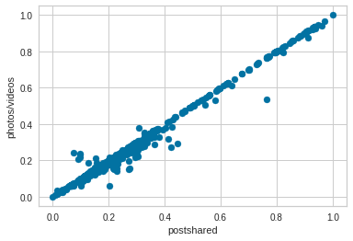
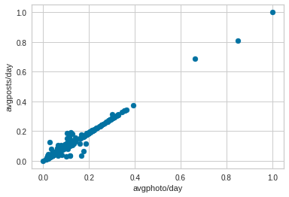
Data pre-processing(3)
Fig : Observing correlation using scatter plot
From the above scatter plots, we can observe that the features (‘postshared’ , ‘photos/videos’ ) and (‘avgphoto/day’ , ‘avgpost/day’) are strictly following linear relationship and they are positively correlated.

Slide 13
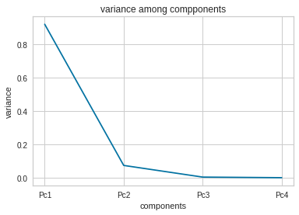
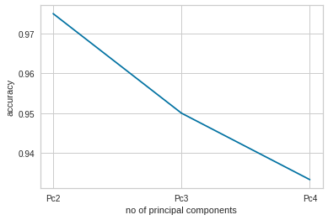
Data pre-processing(4)
7. Principal component Analysis(PCA):
Generally, we take number of principal of principal components that contribute to significant variance and ignore those with diminishing variance returns. Here, we can see that after the second principal component the change in variance almost diminishes. Therefore, first two components is selected.
On comparing the accuracy of all the three cases (with two, three and four component), the first case where we considered first two principal components gives better accuracy score than others. So, we will consider first two principal components for better predictions.

Slide 14
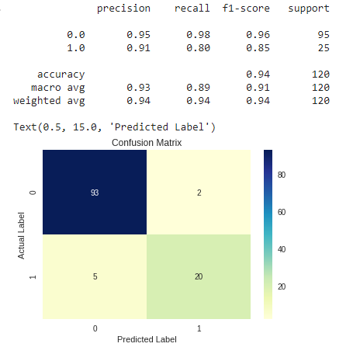
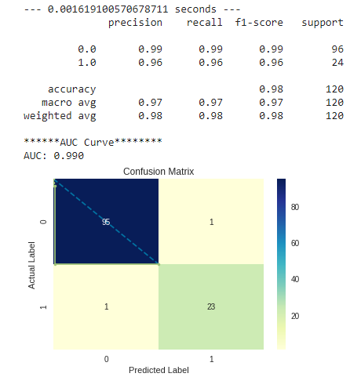
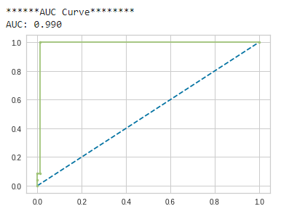
Experiment and Results
Support vector machine classifier

Slide 15
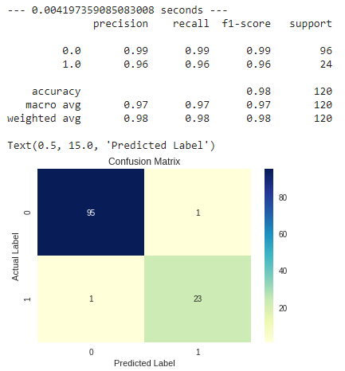
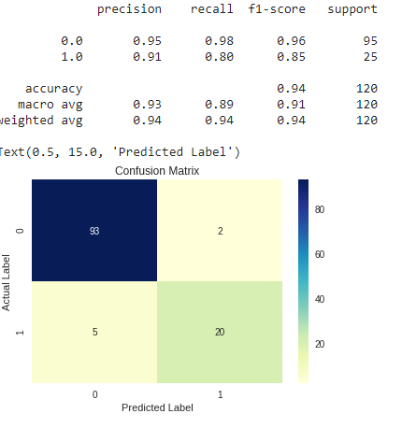
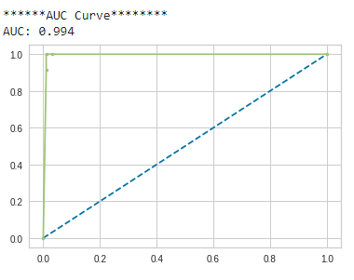
Experiment and Results(2)
Random Forest Classifier

Slide 16
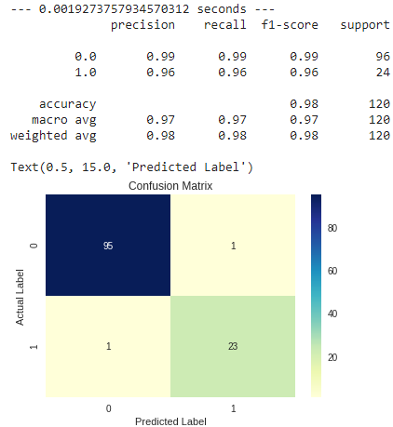
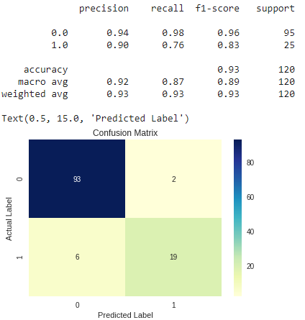
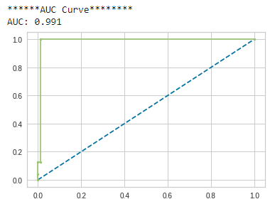
Experiment and Results(3)
Logistic Regression

Slide 17
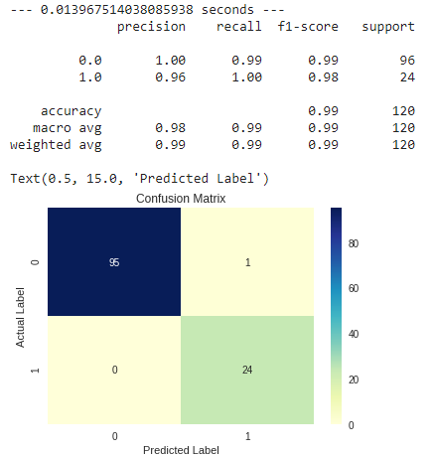
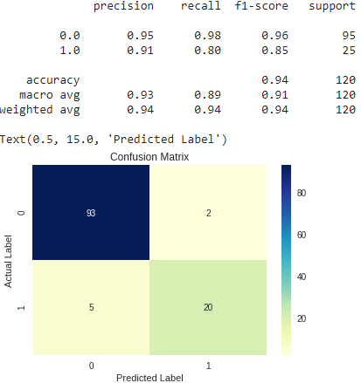
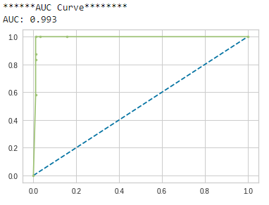
Experiment and Results(4)
K Nearest Neighbors Classifier

Slide 18

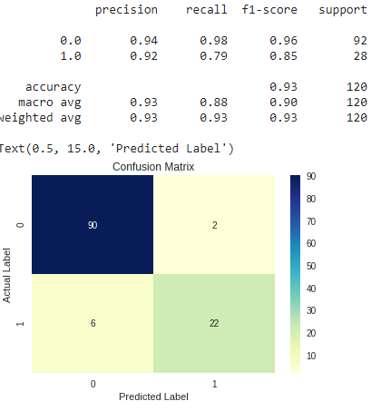
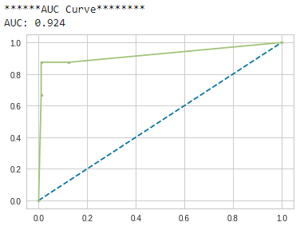
Experiment and Results(4)
Decision Tree

Slide 19
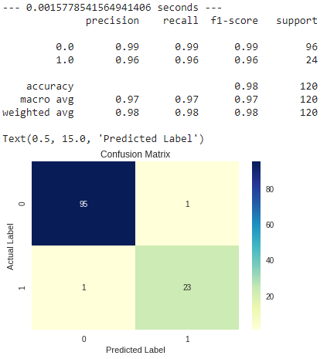
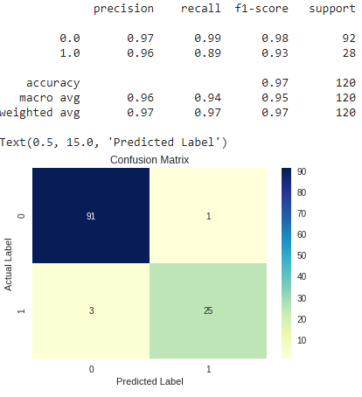
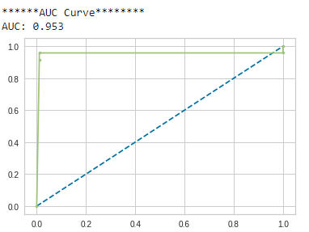
Experiment and Results(4)
Naive Bayes Classifier

Slide 20
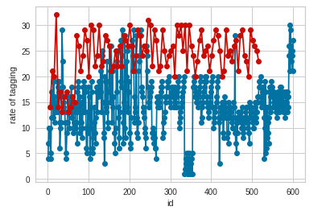
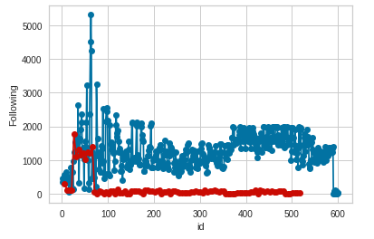
Dissimilarity Graphs

Slide 21
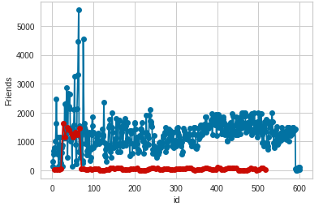
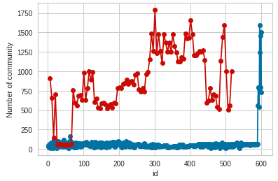
Dissimilarity Graphs

Slide 22
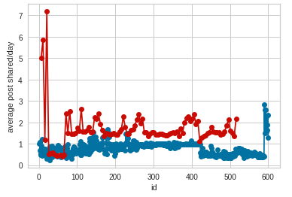
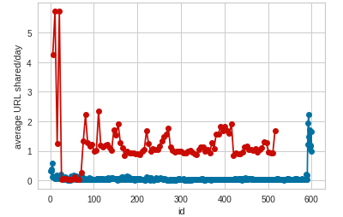
Dissimilarity Graphs

Slide 23
Conclusion
From the analysis of dissimilarity graphs between legitimate and spammer we observed that.
1)Number of followers of spammer profiles is significantly lower ,while legitimate profiles have high in number of followers.
2)Spammer share high amount of posts that contain photos/videos compare to legitimate profiles.
3)Number of friends of spammer profile is lower as compared to legitimate profiles.
4)We also observed that spammers utilize the hashtags/urls too frequently in their posts.
Our evaluation results show that the framework achieved good performance with 99% accuracy,98.5 %F-score and 98.8% AUC score.
So the proposed profile and content based features enhance the spammer detection on facebook.

Slide 24
Reference
SpamSpotter: An efficient spammer detection framework based on intelligent decision support system on Facebook [https://www.sciencedirect.com/science/article/abs/pii/S1568494617305719]
Hyper parameter tuning
[https://scikit-learn.org/stable/modules/generated/sklearn.model_selection.GridSearchCV.html]
PCA
[https://scikit-learn.org/stable/modules/generated/sklearn.decomposition.PCA.html]

Slide 25
Thank You

